Slide 1
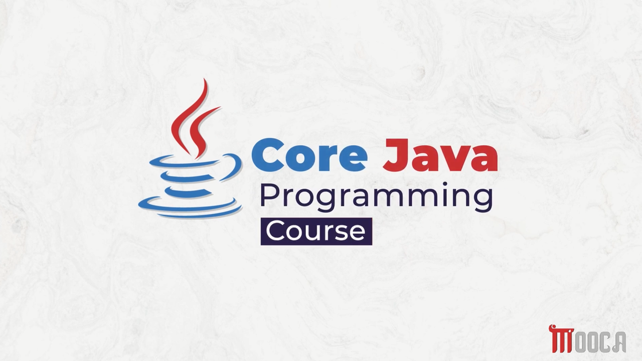

Slide 2
✍Lecture 3:
Primitive Data types .
Literals in java .
Variables .
Type Casting .
Arrays .
Lab 3.

Slide 3
✍Lecture 4 :
The Arithmetic and Bitwise Operators
The Relational and Boolean Logical Operators
The Ternary and instanceof Operators
Tha Arrow Operator and Lambda Expression
Selection Statements
Iteration Statements
Jump Statements
Java String
String Methods
StringBuffer, StringBuilder and StringTokenizer
Lab 4 .

Slide 4
✍Lecture 5 :
Java Packages
Import Packages
Interfaces
Implementing Interfaces
General Considerations
Functional Interfaces
Predefined Functional Interfaces
Lab 5 .

Slide 5
✍Lecture 6 :
Wrapper Classes
Annotations
Annotations Basics
Lab 6 .

Slide 6
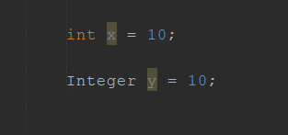


What is a Wrapper Class
A Wrapper Class converts a primitive value into an object.

Slide 7
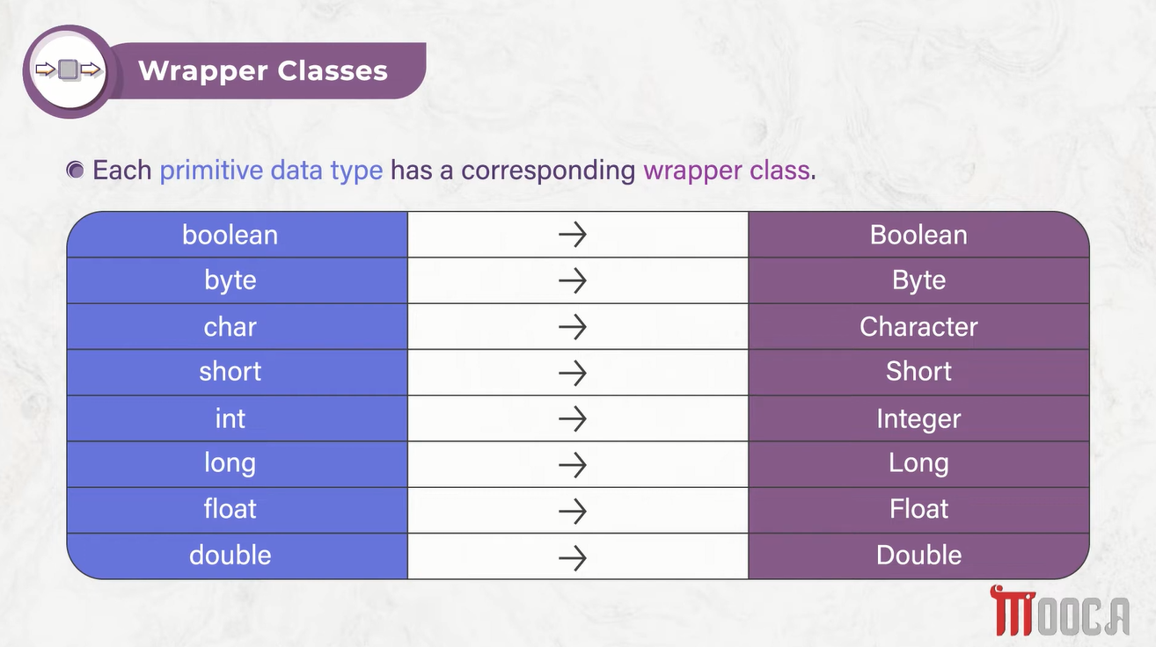



Slide 8
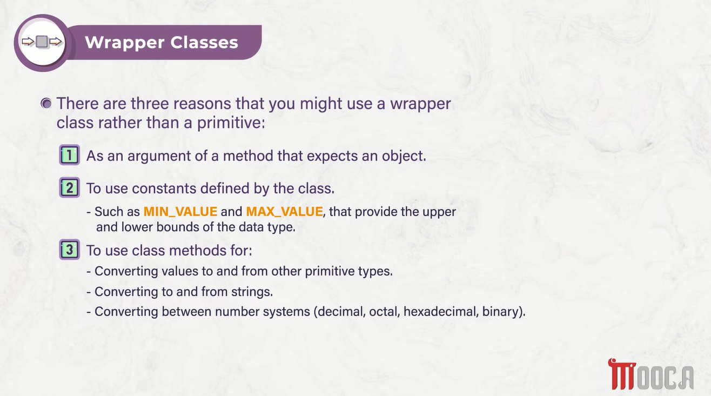


Slide 9
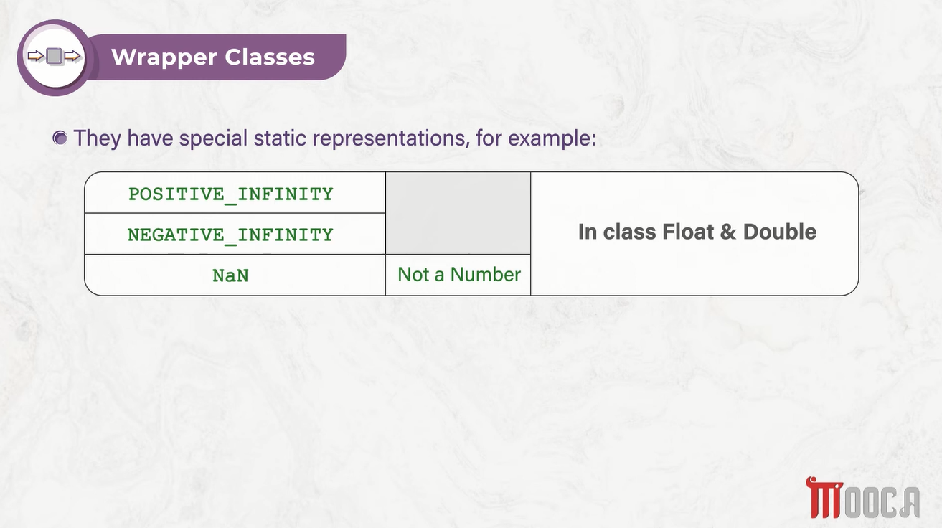

Slide 10
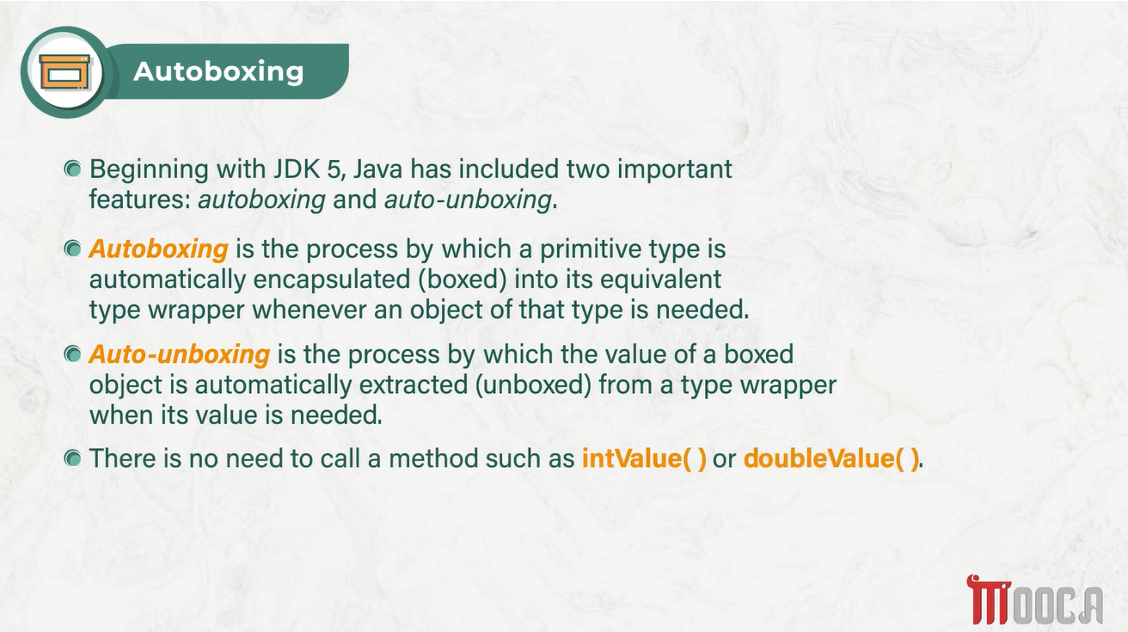

Slide 11




✍Primitive vs Wrapper
Primitive | Wrapper
int | Integer
Stores a value | Object
No methods | Has methods
Cannot be used as Object | Can be used as Object
Usually simpler/faster | Needed when Object is required

Slide 12
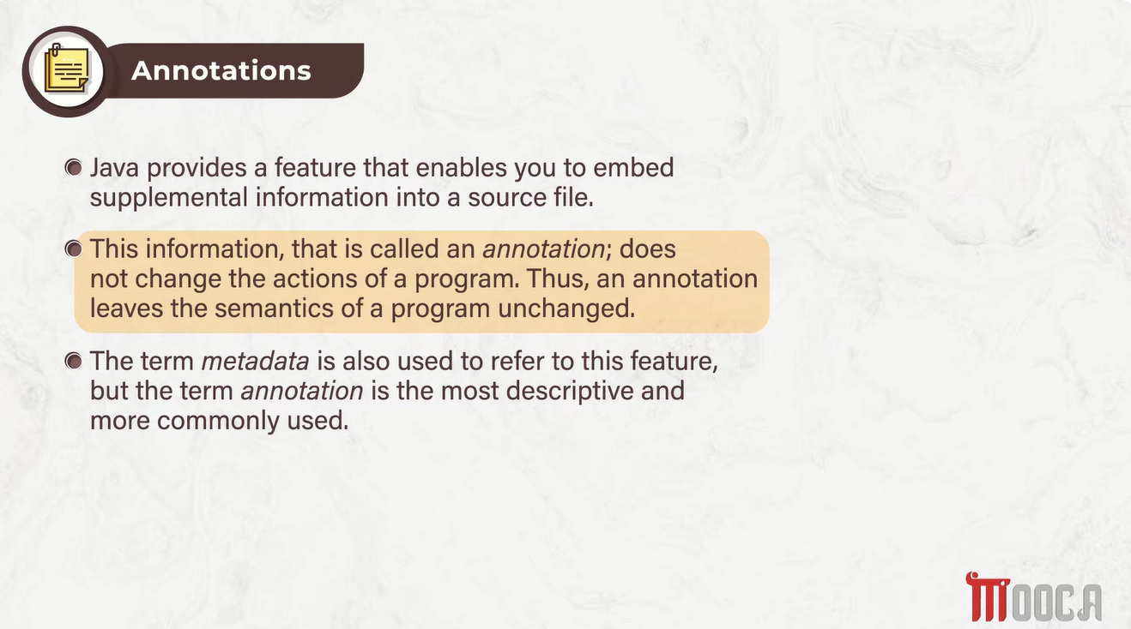
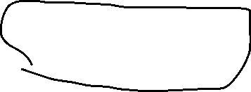


Slide 13
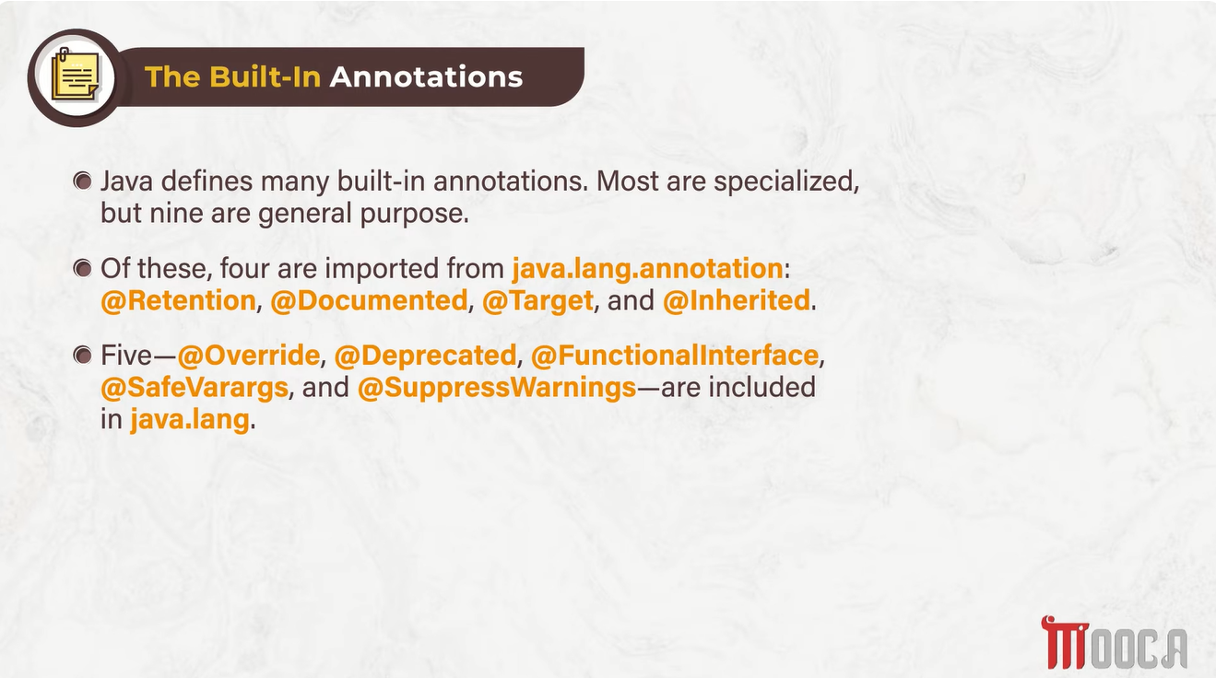

Slide 14
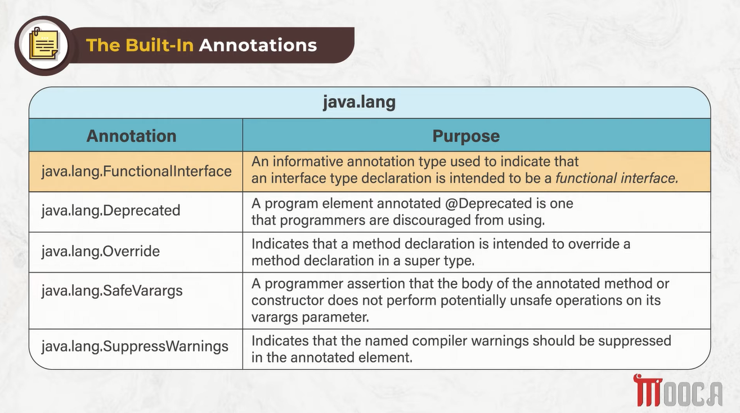




Slide 15
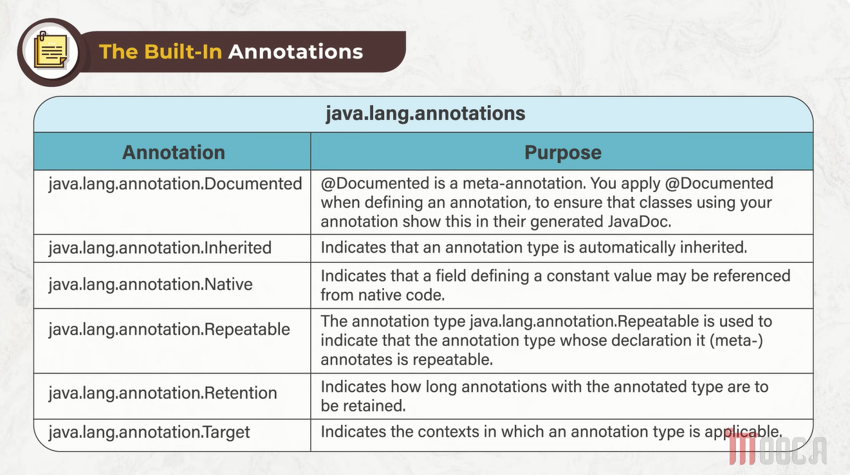

Slide 16
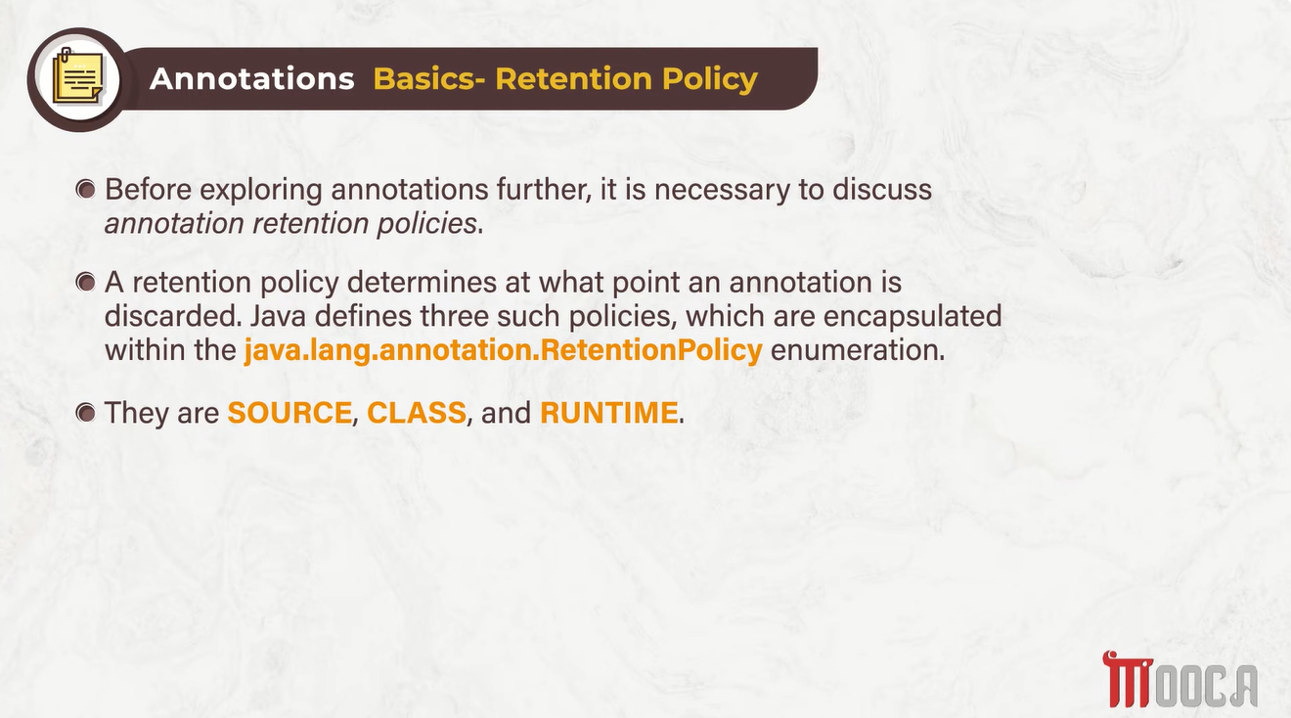

Slide 17
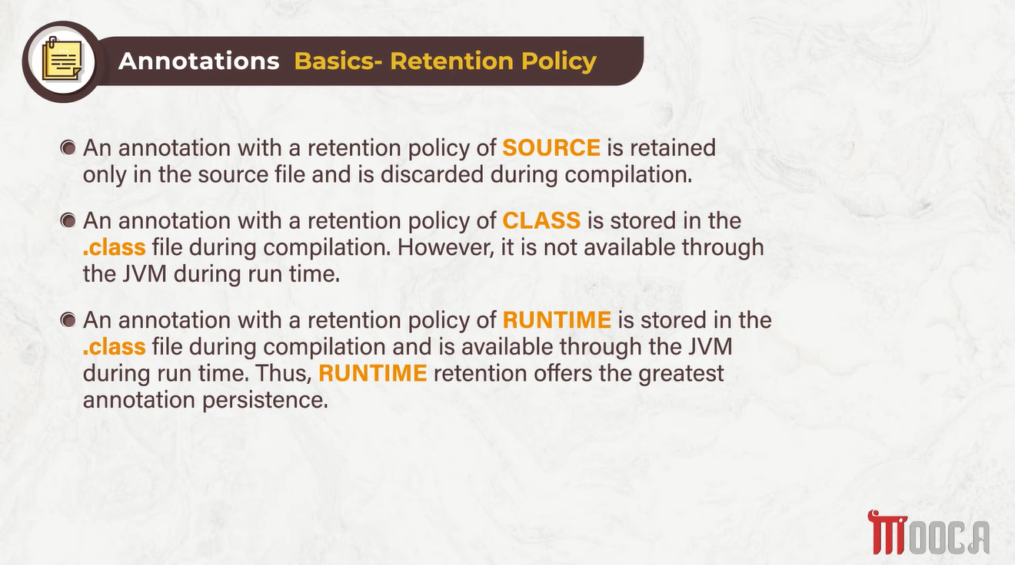

Slide 18
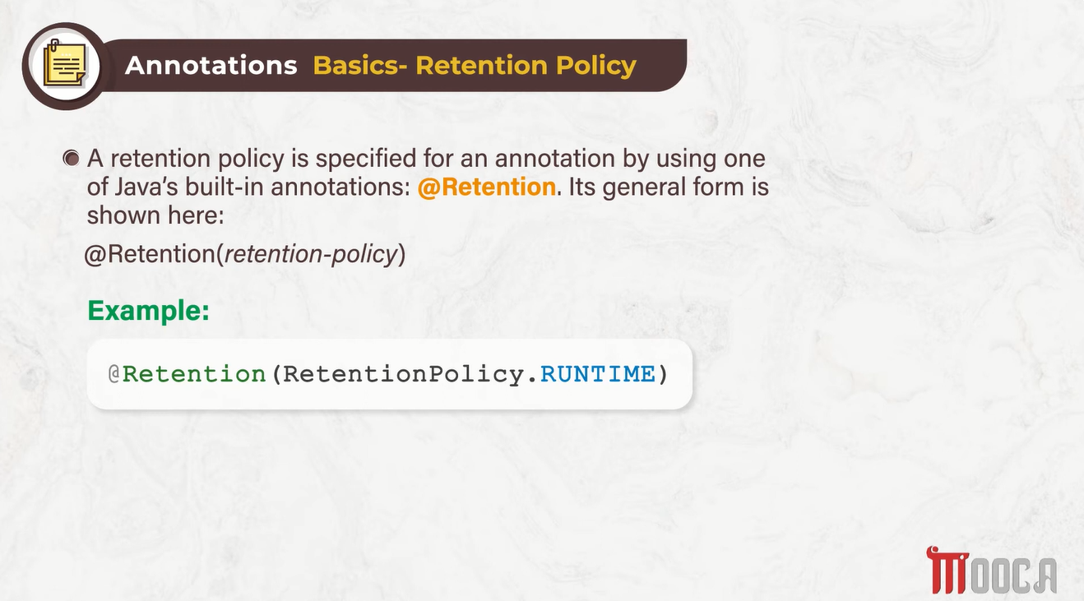

Slide 19
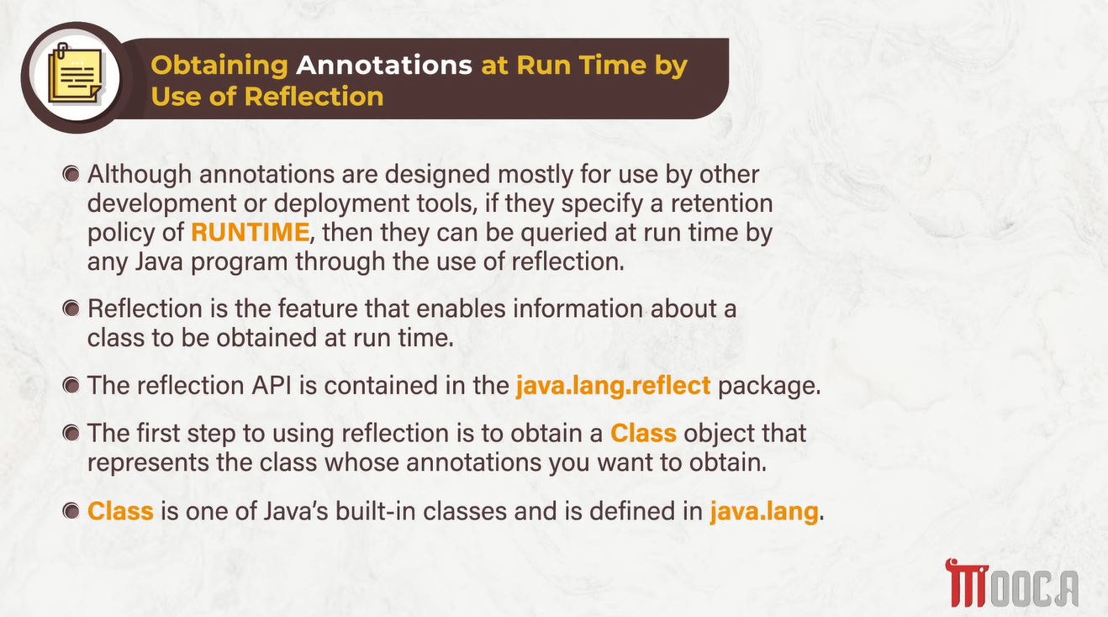

Slide 20
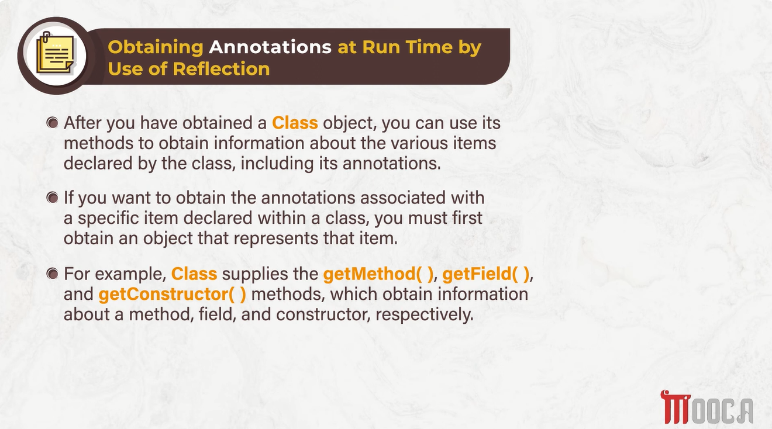

Slide 21
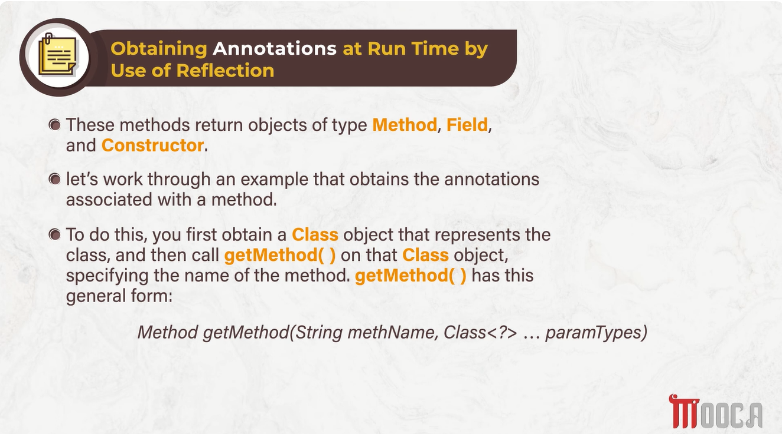

Slide 22
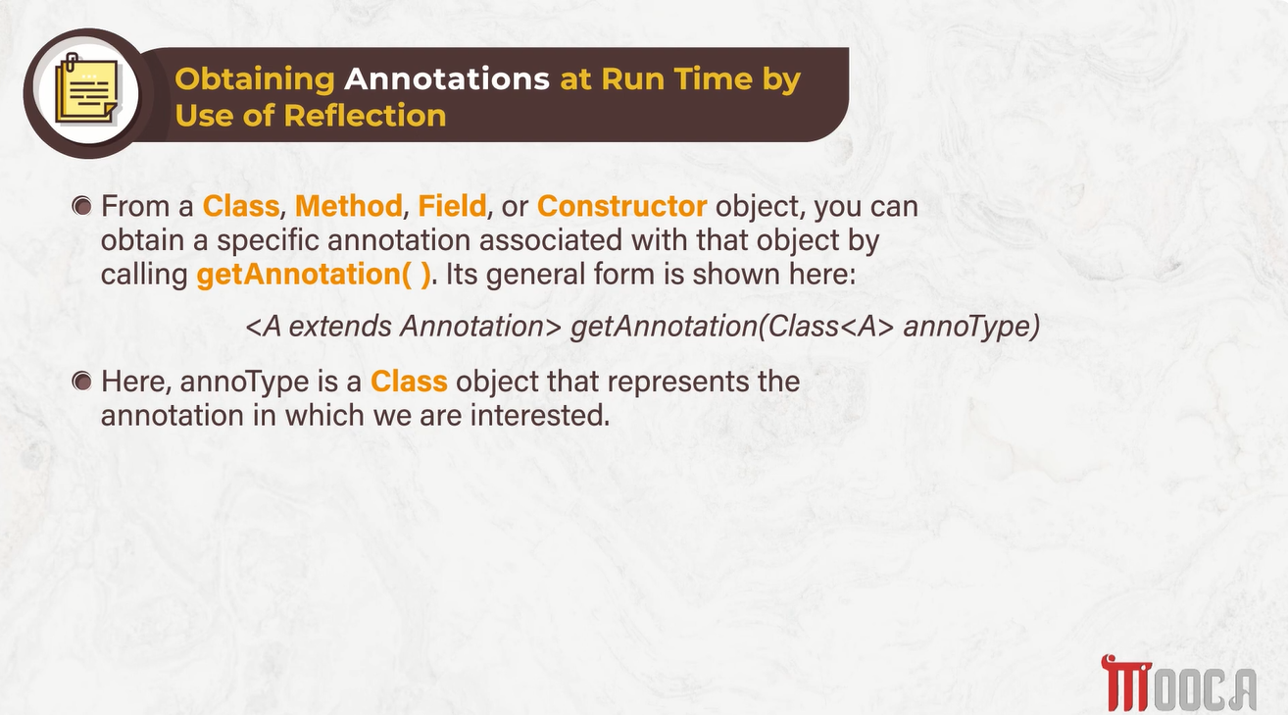

Slide 23
